Slide 1


Our Team:
K.Krishna-077
K.Rushitha-090
U.Sneha-107
-A Woman Safety App

Slide 2
PROBLEM STATEMENT:
Nearly 31,000 women complaints of crime against women in India in 2021 . This is increased by 40% of the cases than compared to 2020.
Are all the women getting justice on the assault happened to them , This should be considered as a major issue now..

Slide 3
ABSTRACT
There are many crimes against women are showing up not only physically but also through social media channels.
It is already a challenge for survivors to obtain justice in the Indian legal system.The atrocities against women can be brought to an end with the help of web application "FEMZO".
This website is developed primarily to provide security and safety to women in need, specially designed for women in distress.
Our product basically helps the victim to file a complaint on the assault happened to her.The user can find the location is safe for her to travel and the system predicts based on internal variables .
Also ,on an emergency note the victim can send her current location to 1 or more emergency contacts listed in the website while registering to the website on one go.They can chat with organization for user’s queries at any time .
Profile and dashboard are maintained to track the files complained by the user and organization

Slide 4






Design
Database
Sends request to the backend framework
Request for data
Predictions
Fetches data and predicts output .
Requested data is displayed
Front End Framework
ML algorithms

Slide 5
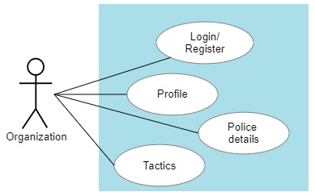
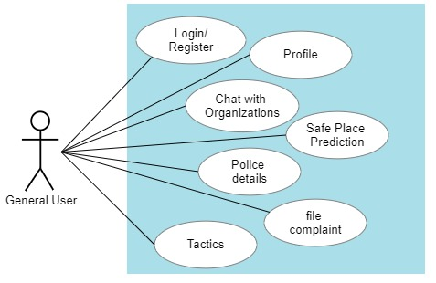
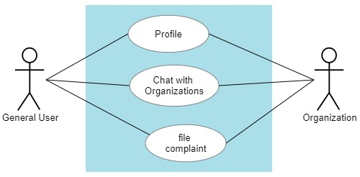
Use Case

Slide 6
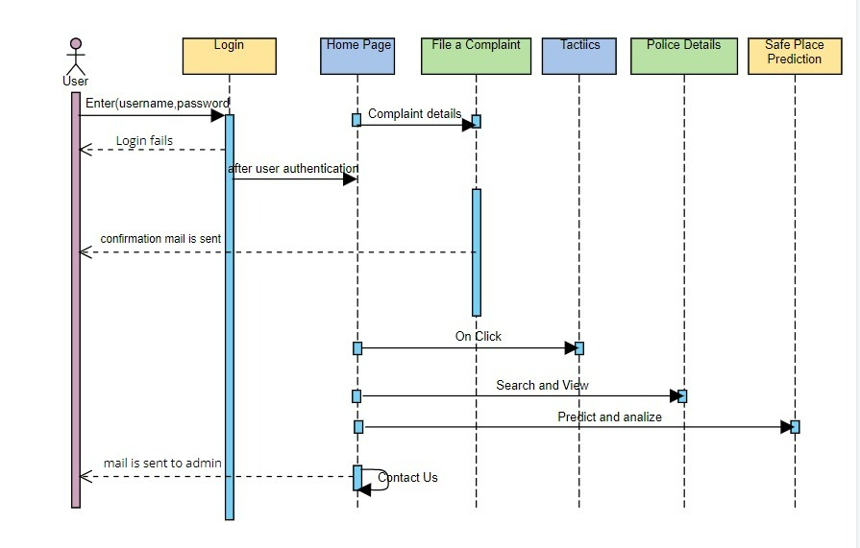
SEQUENCE DIAGRAM

Slide 7
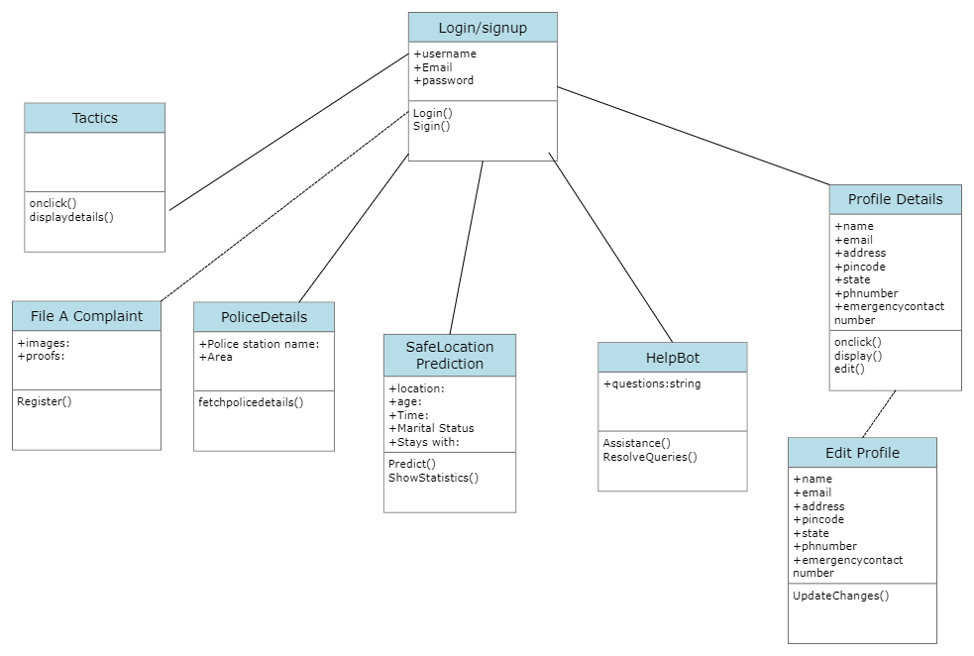
CLASS DIAGRAM

Slide 8
DATA FLOW DIAGRAM
File A Complaint
USER
Login/Register
Tactics
No
Get Police Details
System
Yes
Verifies
Profile
Chat With Organization
Login
No
ADMIN
Safe Place Prediction

Slide 9
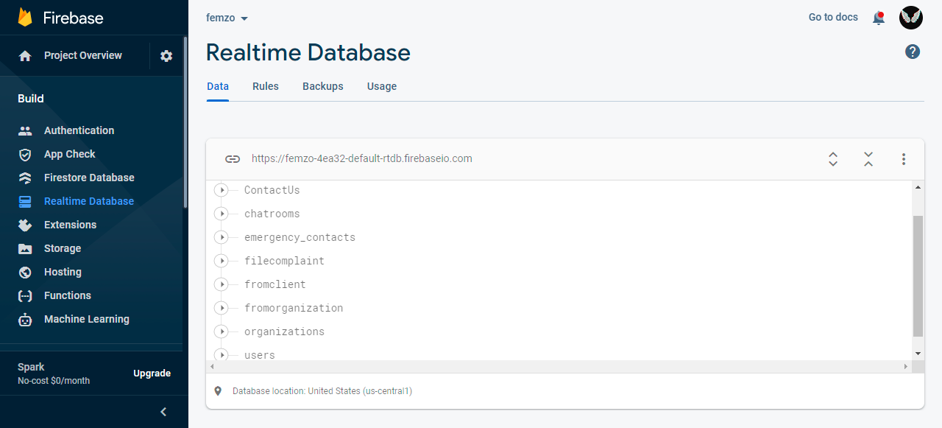
DataBase Schema

Slide 10

Results :
Home page:

Slide 11
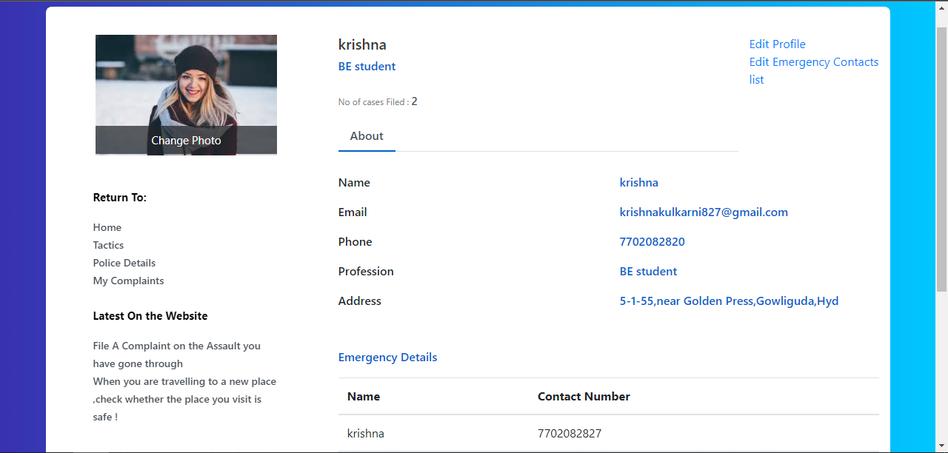
Profile
User Profile:

Slide 12
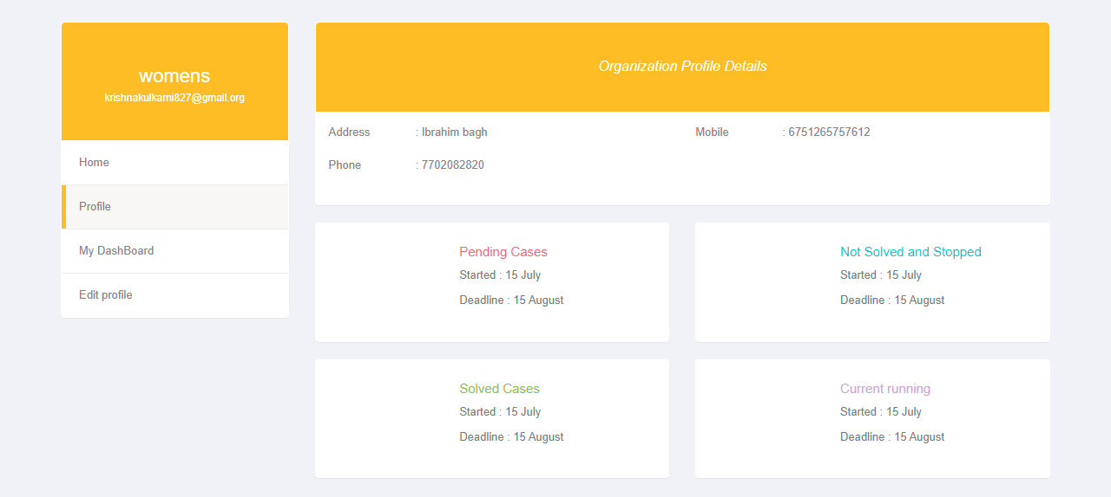
Org Profile:

Slide 13
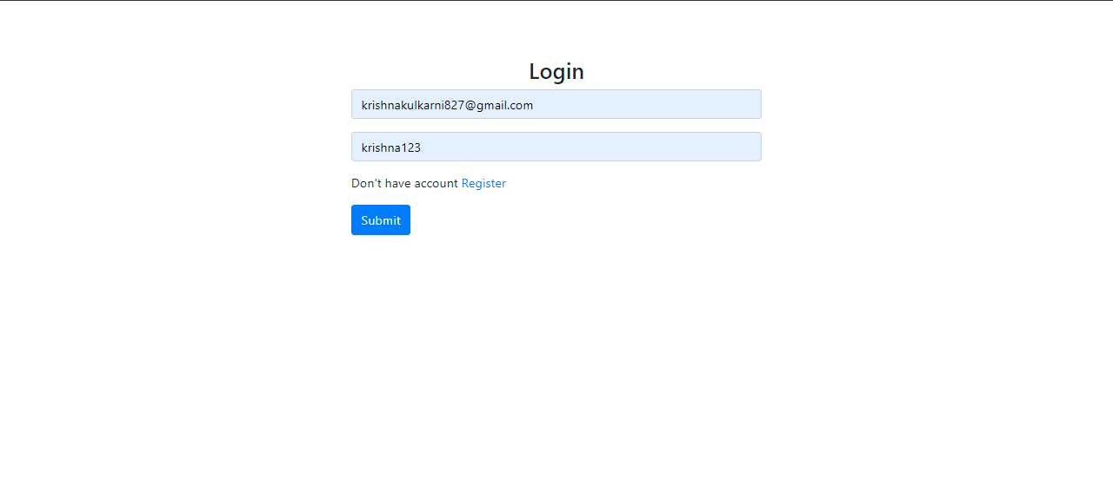
LOGIN/REGISTER:

Slide 14
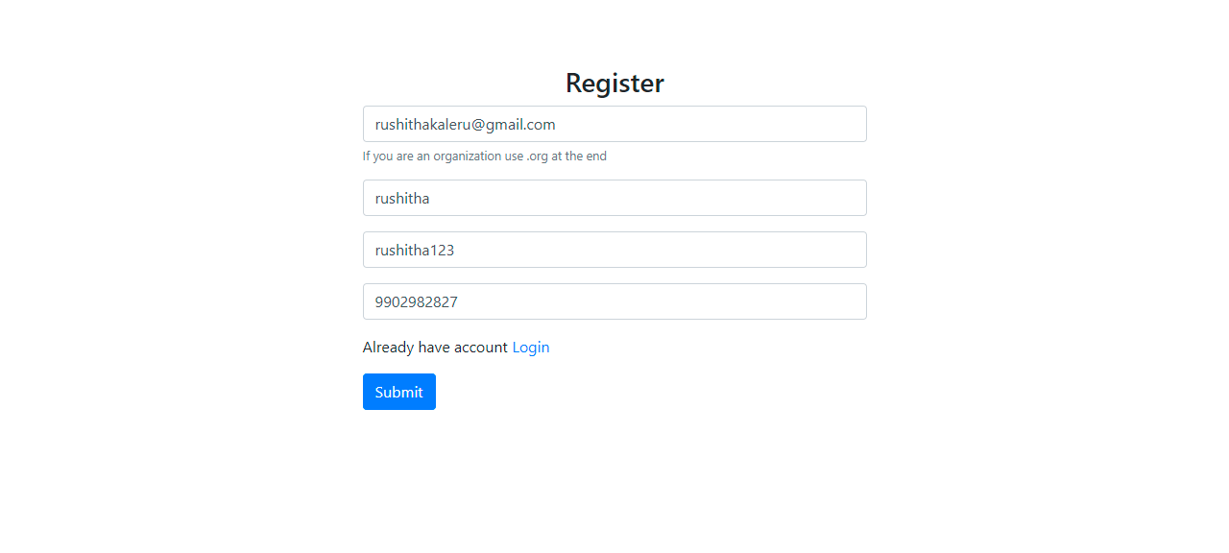

Slide 15
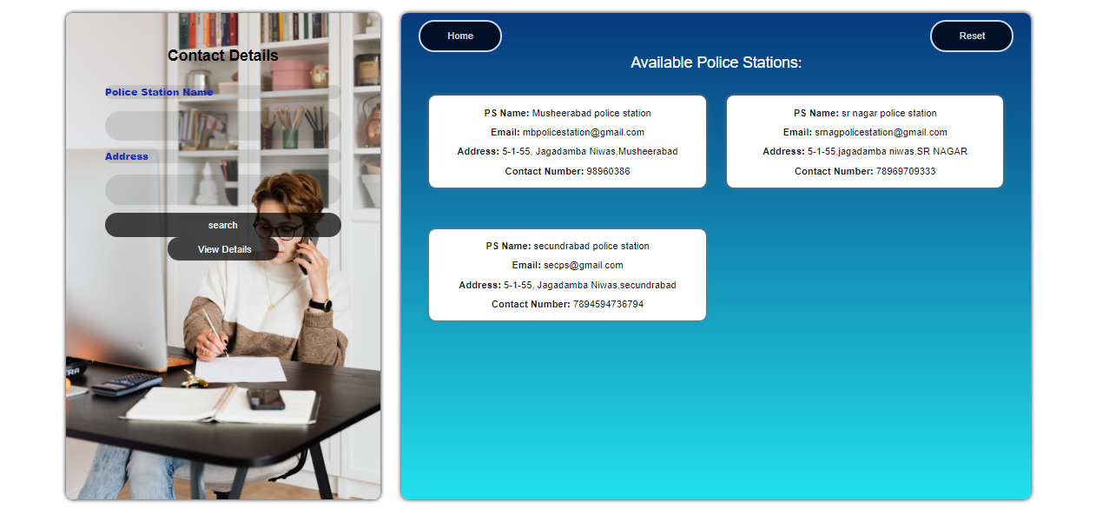
Police Details:

Slide 16
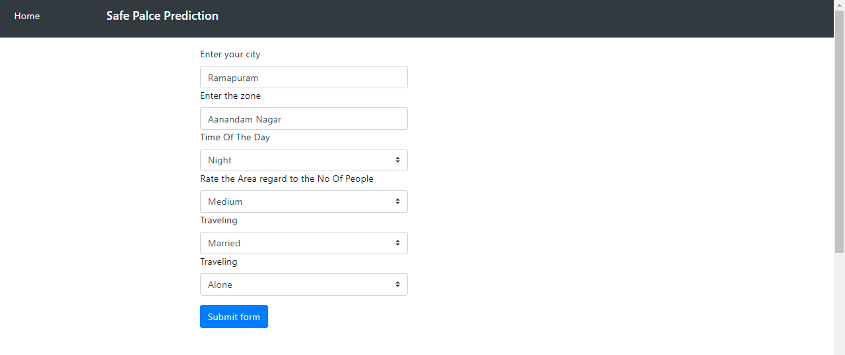
Safe Location Prediction

Slide 17
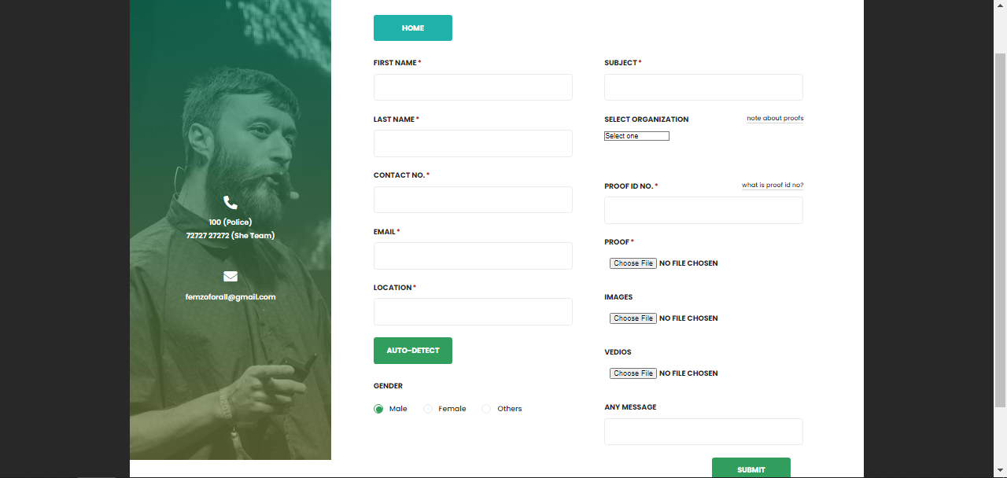
File A Complaint

Slide 18
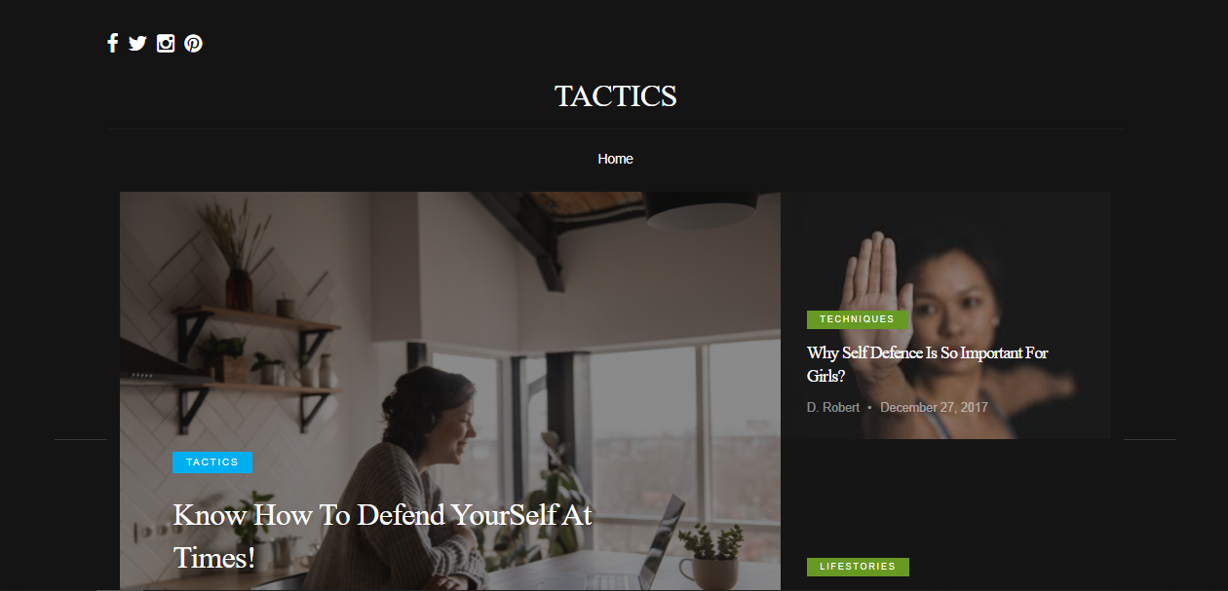
Tactics

Slide 19
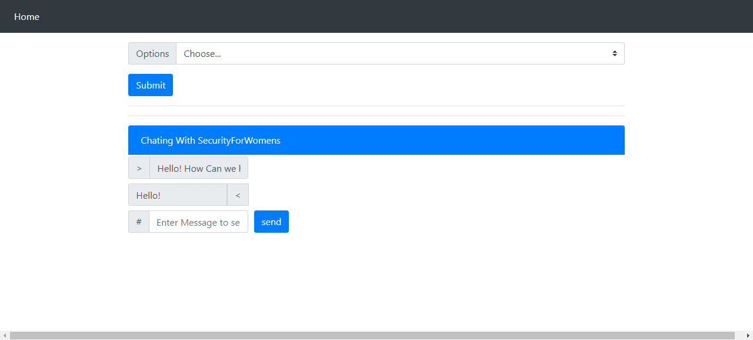
Chat With Organization

Slide 20
THANK YOU

